Slide 1
Learn to anticipate
Chana Ross
December 2019

Slide 2
Problem definition
Mathematical breakdown of problem
Anticipatory planner – mathematical background
Example – Uber , Manhattan
Data analysis
Probability function
Deterministic problem solvers
Anticipatory algorithm
Results
Future work
Summary
Table of contents

Slide 3
Input
Limited known number of agents
Goal
Maximize amount of requests answered throughout a given day using a set number of agents
Real time requests created throughout time (stochastic)
Historical data of previous requests
Minimize overall use of each agent
“On-line Continual Planning Problem – OCPP”
Problem Definition
Anticipatory on-line planning, ICAPS’12
Ethan Burns, J. Benton, Wheeler Ruml, Sungwook Yoon, and Minh B. Do.
Notes:
This is a general problem definition. There are many real world problems that we can define in this structure.
The main point here is that the environment and actions of agents are deterministic, but the goals wanted at each time are stochastic and therefore the problem is stochastic as well.
(if it were deterministic goals we could have solved it using MIP or other methods that we will see later in this presentation)
The basis for our research was presented by wheeler and his team in ICAPs in 2012

Slide 4
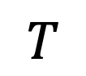


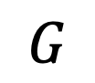
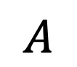
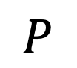
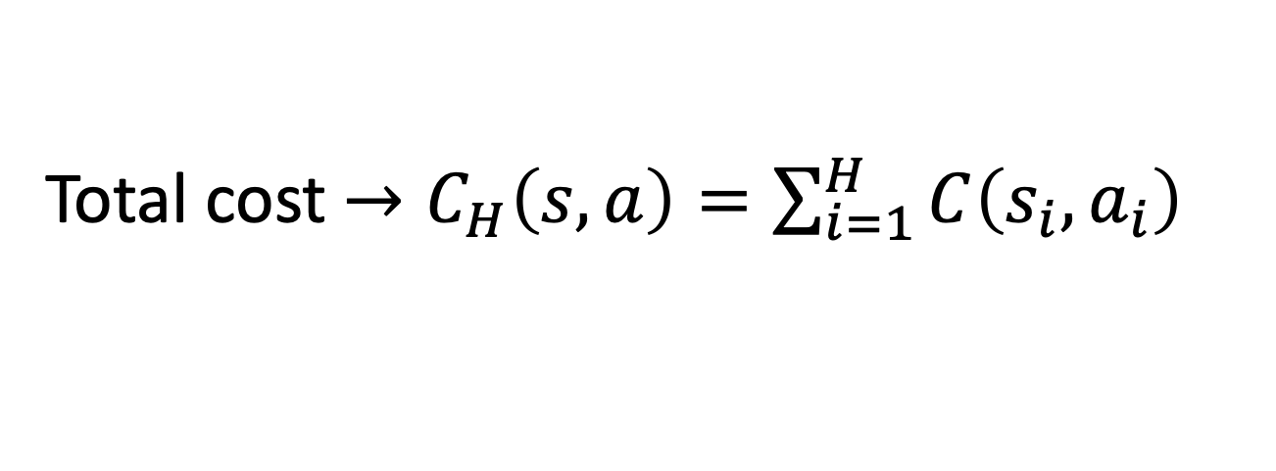
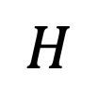
world
known goals
available actions
transition function probability from S’ to S
cost of preforming action A given state S
H – number of look ahead steps
P – distribution of future goals
$$W$$
$$G$$
OCPP - Problem Definition
$$A$$
$$T$$
$$C_{H}$$
$$H$$
$$P$$
Anticipatory on-line planning, ICAPS’12
Ethan Burns, J. Benton, Wheeler Ruml, Sungwook Yoon, and Minh B. Do.
Total cost $→C_{H}\left(s,a\right)=\sum_{i=1}^{H}{C\left(s_{i},a_{i}\right)}$
Notes:
Before we go on solving the problem we want to define some notations that will be used throughout the presentation.
Assuming we have a world with goals that are created throughout time from a transition function which takes us at each timestep from state S to S’.
At each time we have set of agents that can preform a number of actions – A, these actions are known and similar at each time.
The cost of preforming the actions is also known and is effected by the ability of our agents to supply the goals.
The problem changes throughout time therefore there is no need to plan a full policy but only to determine H steps ahead at each given time.
P is the distribution of future event

Slide 5
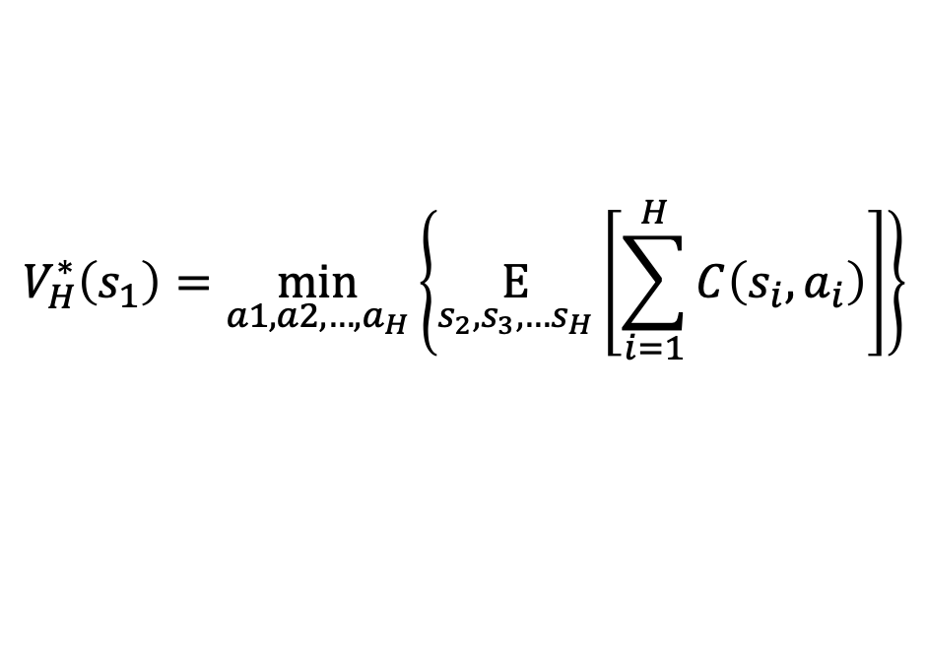

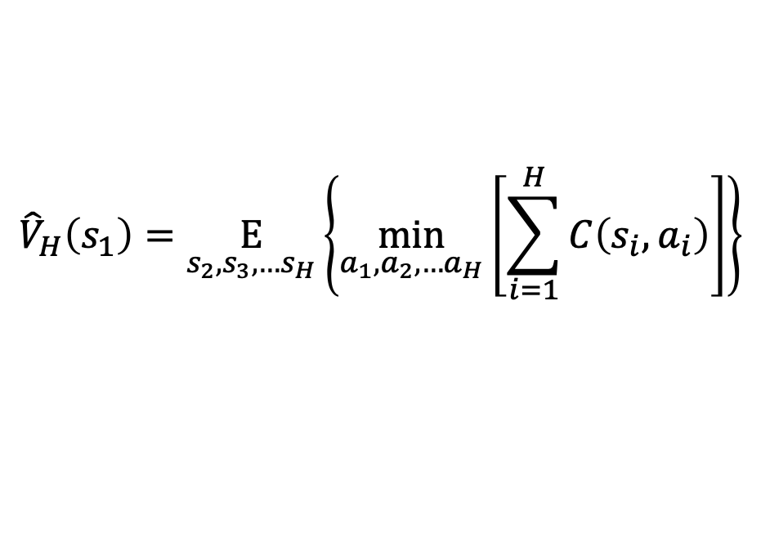
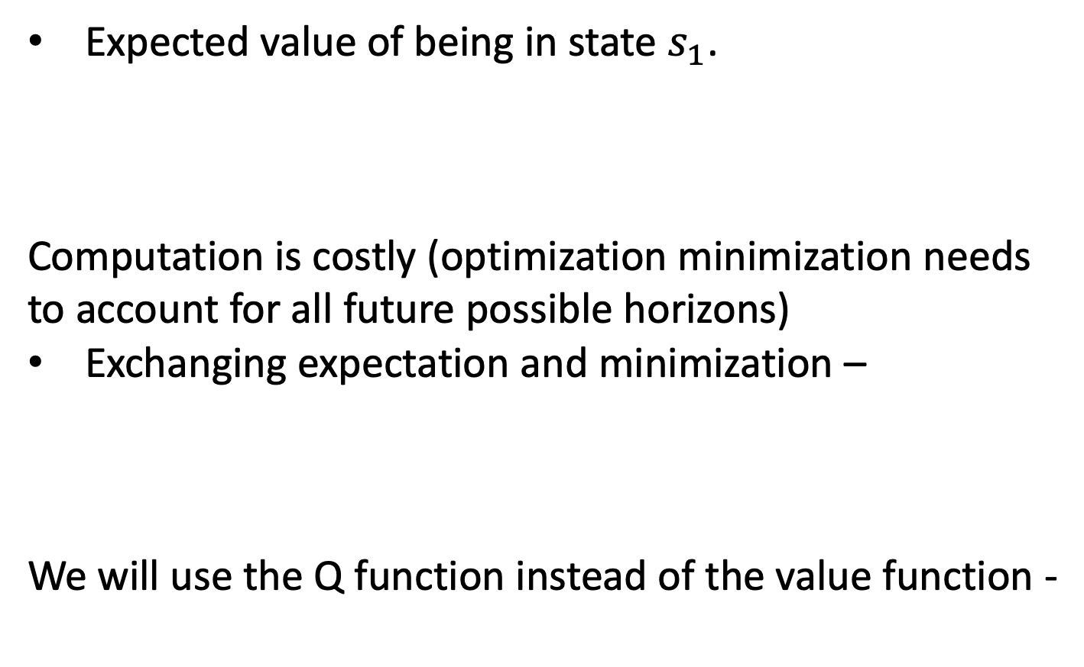
Expected value of being in state $s_{1}$.
Computation is costly (optimization minimization needs to account for all future possible horizons)
Exchanging expectation and minimization –
We will use the Q function instead of the value function -
$$V_{H}^{∗}\left(s_{1}\right)=\min_{a1,a2,…,a_{H}}\left\{\underset{s_{2},s_{3},…s_{H}}{E}\left[\sum_{i=1}^{H}{C\left(s_{i},a_{i}\right)}\right]\right\}$$
Anticipatory planner – mathematical background
$${\hat{V}}_{H}\left(s_{1}\right)=\underset{s_{2},s_{3},…s_{H}}{E}\left\{\min_{a_{1},a_{2},…a_{H}}\left[\sum_{i=1}^{H}{C\left(s_{i},a_{i}\right)}\right]\right\}$$
$$\hat{Q}\left(s_{1},a_{1}\right)=C\left(s_{1},a_{1}\right)+{\hat{V}}_{H}\left(s_{1}\right)$$
Anticipatory on-line planning, ICAPS’12
Ethan Burns, J. Benton, Wheeler Ruml, Sungwook Yoon, and Minh B. Do.

Slide 6
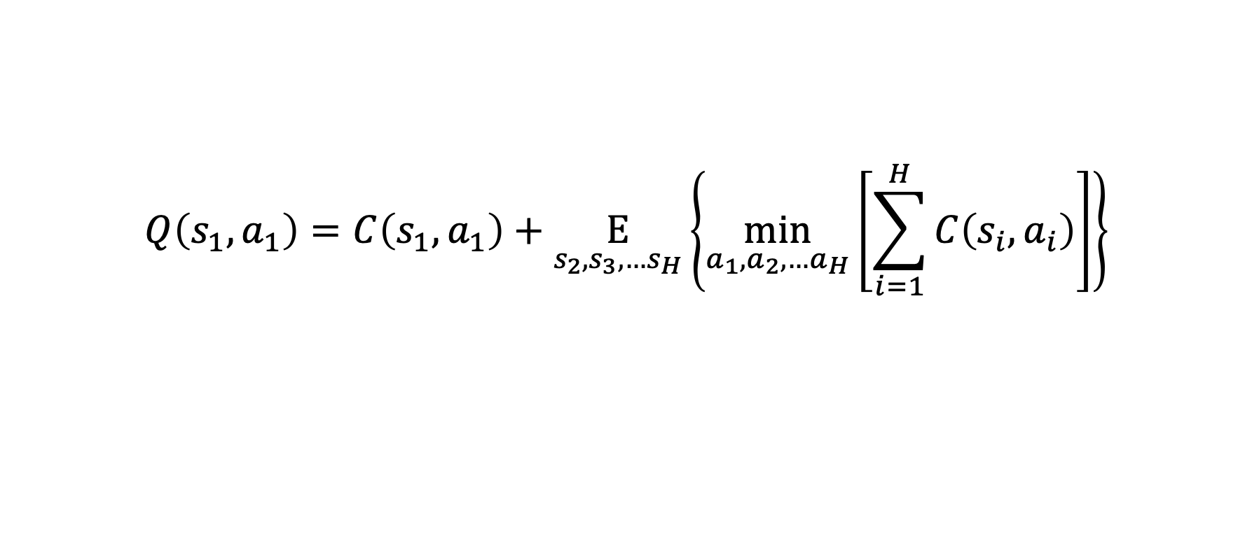
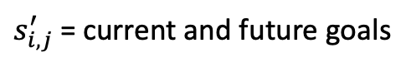
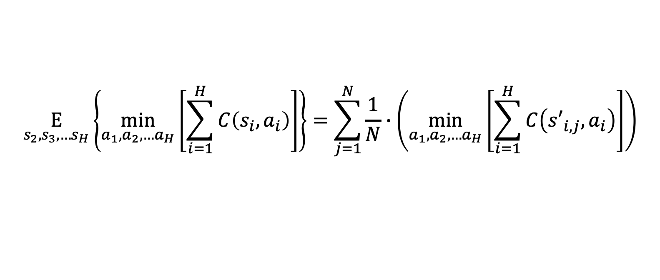
Expected goals from distribution
$$Q\left(s_{1},a_{1}\right)=C\left(s_{1},a_{1}\right)+\underset{s_{2},s_{3},…s_{H}}{E}\left\{\min_{a_{1},a_{2},…a_{H}}\left[\sum_{i=1}^{H}{C\left(s_{i},a_{i}\right)}\right]\right\}$$
Anticipatory planner - explained
Real cost of moving each vehicle and picking up goals reached
Deterministic problem of real goals and future goals sampled from known distribution
$$\underset{s_{2},s_{3},…s_{H}}{E}\left\{\min_{a_{1},a_{2},…a_{H}}\left[\sum_{i=1}^{H}{C\left(s_{i},a_{i}\right)}\right]\right\}=\sum_{j=1}^{N}{\frac{1}{N}∙\left(\min_{a_{1},a_{2},…a_{H}}\left[\sum_{i=1}^{H}{C\left({s′}_{i,j},a_{i}\right)}\right]\right)}$$
Anticipatory on-line planning, ICAPS’12
Ethan Burns, J. Benton, Wheeler Ruml, Sungwook Yoon, and Minh B. Do.
$s_{i,j}^{′}$ = current and future goals
N = num stochastic runs

Slide 7
 | “Anticipatory online planning” Bernie et al. | Our solution
Distribution | Known function | Learned from historical data
Deterministic Solver (run time) | A* Slow run time Limited problem size | MIP Fast (max flow) Problem size unlimited
Problem Size | 3 agents 7*7 grid P(1 event) = 0.04 | 5+ agents 50*10 grid (not limited) P(multiple events) > 0.1
What’s new?
Anticipatory on-line planning, ICAPS’12
Ethan Burns, J. Benton, Wheeler Ruml, Sungwook Yoon, and Minh B. Do.

Slide 8
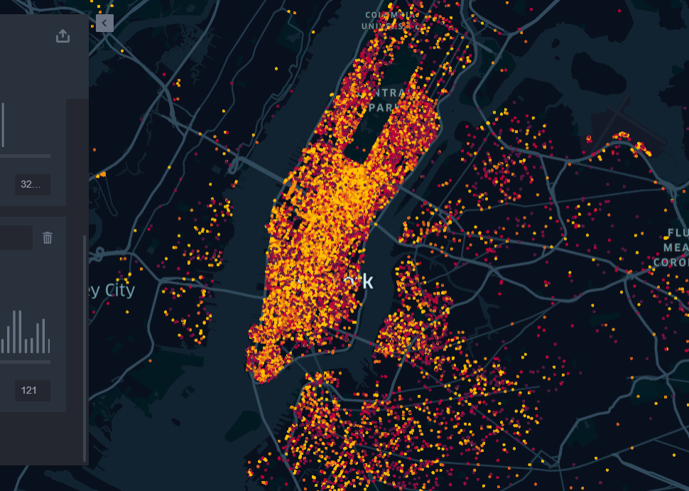
Example – Uber Manhattan

Slide 9
Data
Input
April - September 2014
https://github.com/fivethirtyeight/uber-tlc-foil-response
Number of available drivers
Stochastic requests throughout the day
Goal
Baseline
Minimize route for each driver
Maximize amount of requests answered
Deterministic optimal solution
Greedy linear sum assignment based on distance matrix
Problem Definition Uber

Slide 10
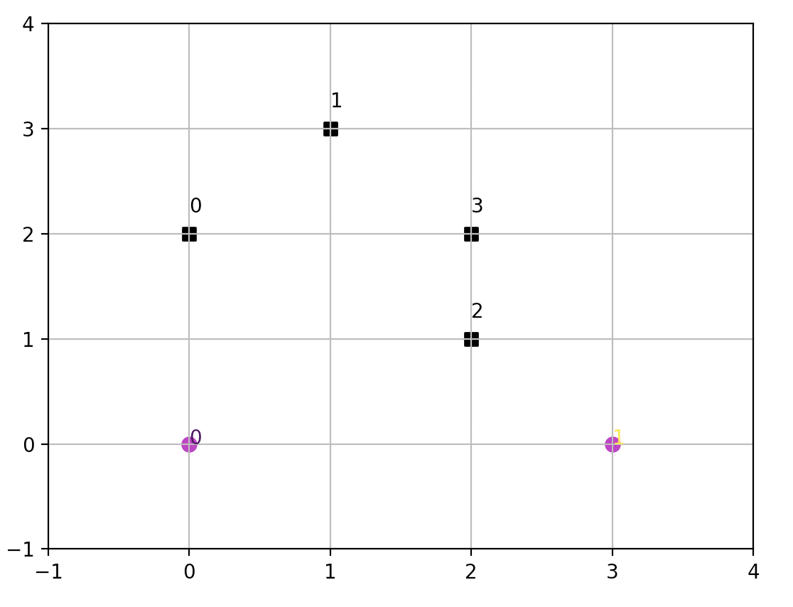

Cost : [reward for pickup] - [cancelation fee] - [driving fee]
Problem assumptions
Cancellation time
Possible actions
Costumers
cars

Slide 11
1. Data Analysis
Organize data
Understand patterns (if exist)
2. learning prediction function
learn the historical data and create probability function to estimate expected value of actions
3. Deterministic solver
Find solver for calculating expected value of deterministic runs
4. anticipatory algorithm
5. Accelerate run time
run anticipatory algorithm and compare to baselines
improve run time and run on large-scale problems
Steps for solution

Slide 12
Grid Rotation
Data Cropped : Manhattan
Limited number of events (<20)
$$Δt=30 min. Δx,Δy=500 m$$
Δt=30 min. Δ𝑥,Δ𝑦=500 𝑚
Step 1 : Data analysis

Slide 13
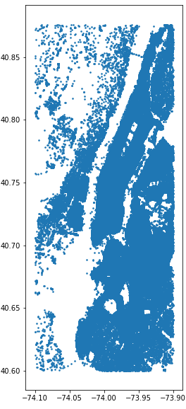
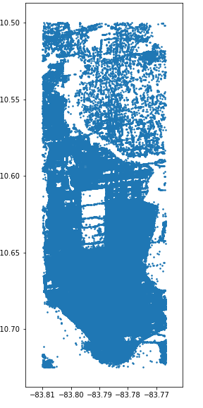
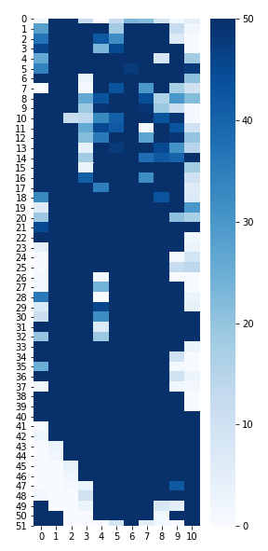
Rotated + Cropped data
Original data
Aggregated
Step 1 : Data analysis
Central park

Slide 14
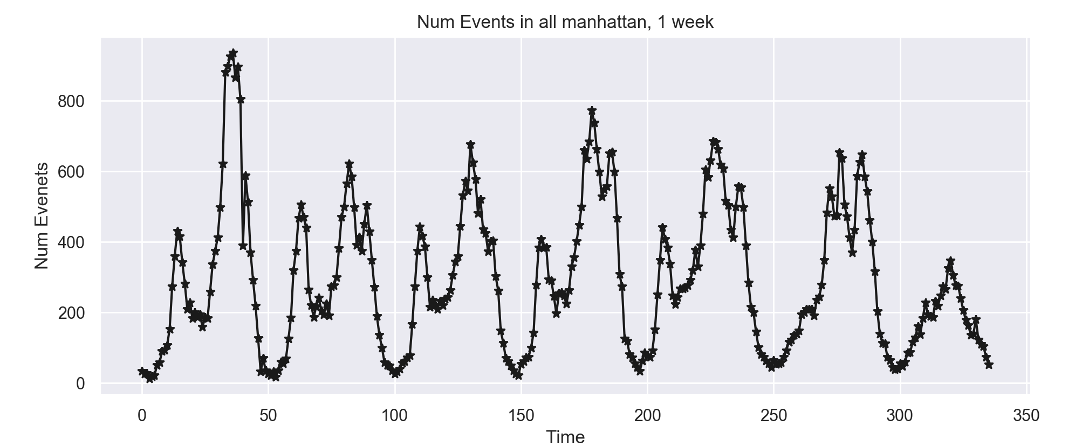
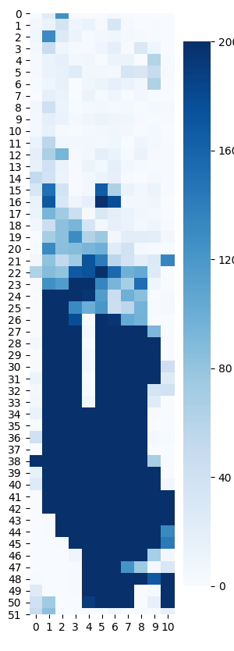
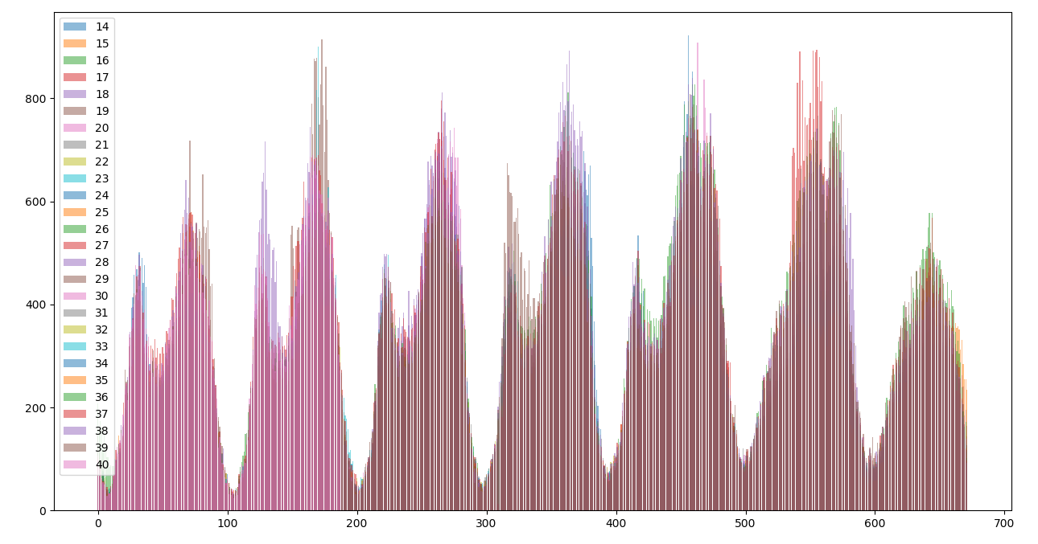
Temporal distribution, all locations, 1 week
Spatial Distribution , 1 week
Step 1 : Data analysis
All weeks have similar behavior

Slide 15
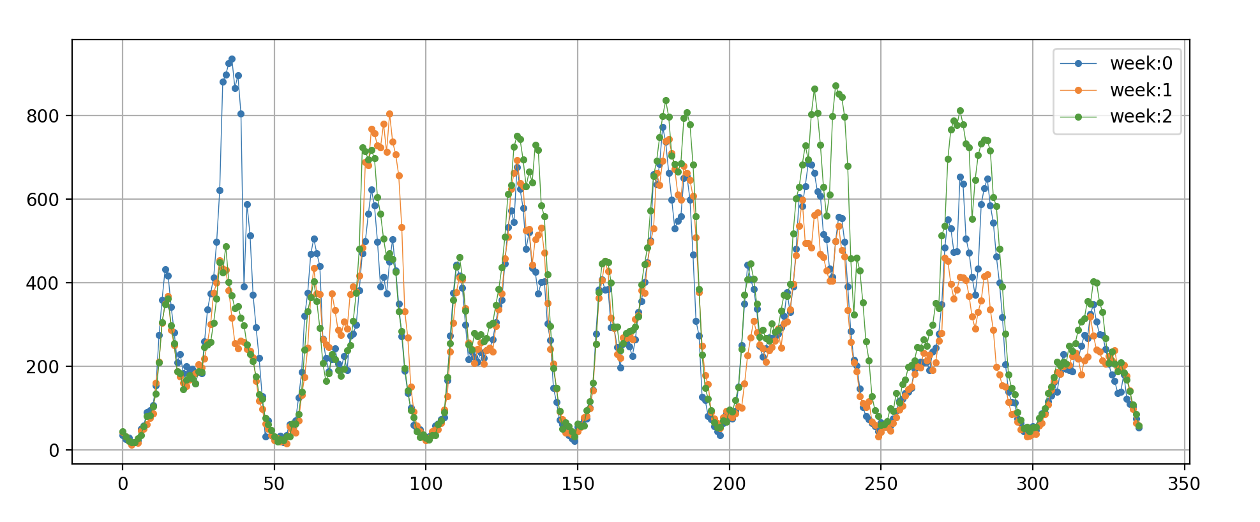
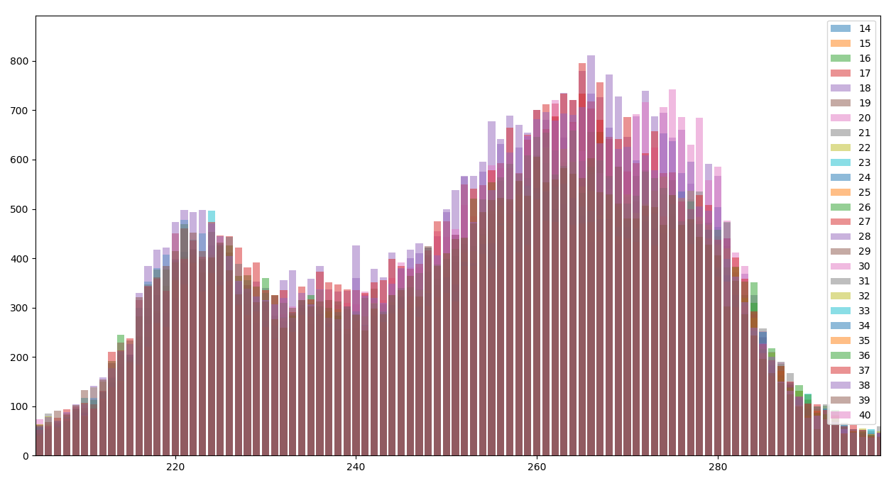

Prior knowledge:
Understand the patterns in data and create probability function based on patterns
All weeks have a similar behavior (location and time wise)
$$p\left(n_{events} | t,x,y\right)=\frac{1}{k}\sum_{i=1}^{k}{n_{events}}$$
K = number of weeks , t=time index ,
x,y = location index
$p\left(n_{events} | t,x,y\right)$ – probability of having n events at location x, y and time t
t - day, hour and minute during the week ($0≤t≤336)$
Step 2 : Probability Function, Average
Evening peak home
Morning peak to work

Slide 16
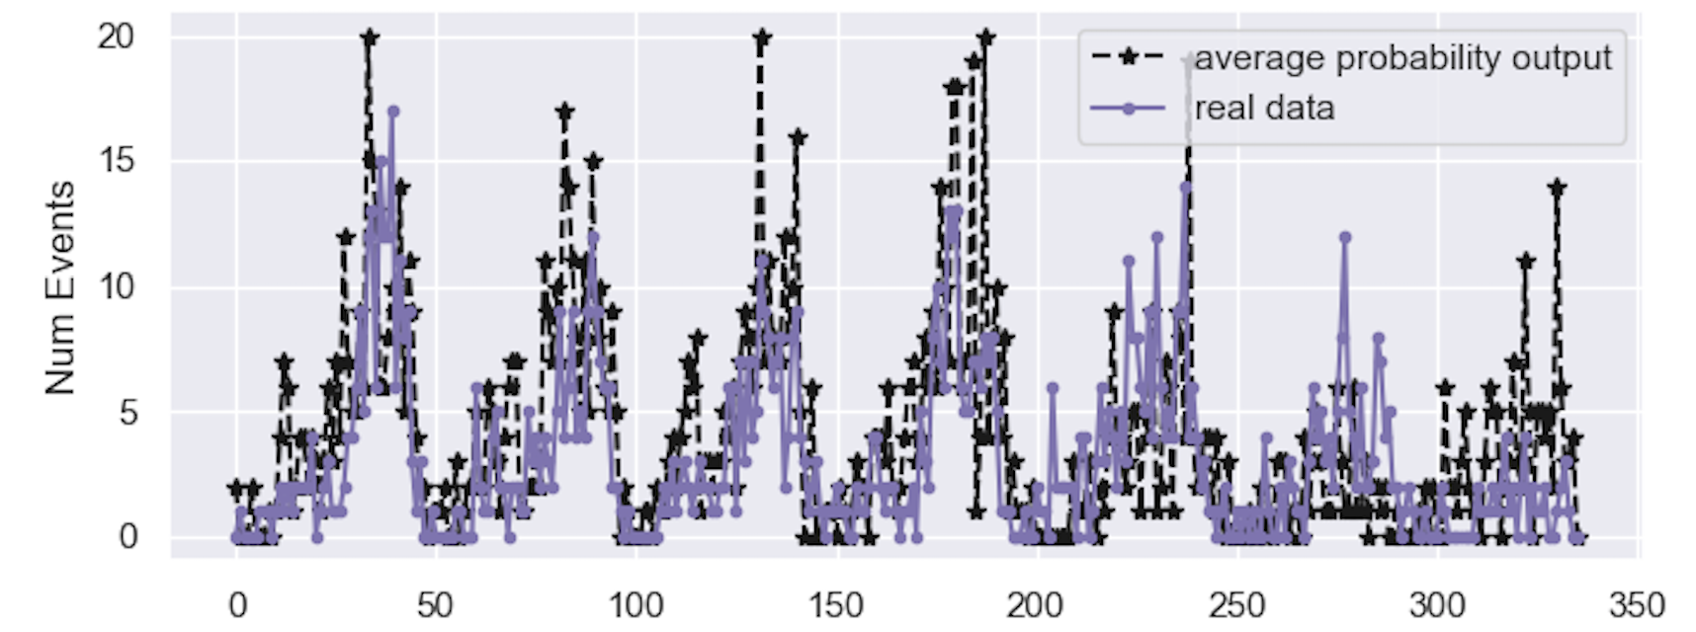
Step 2 : Probability Function, Average

Slide 17
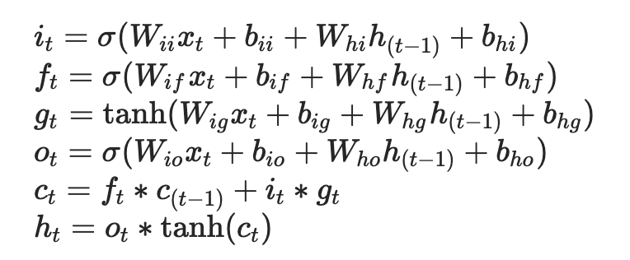
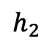
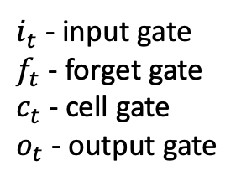
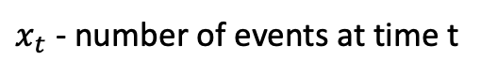
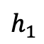
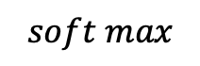
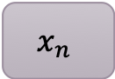
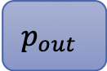
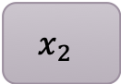
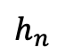
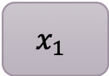

Data is sparse and therefore the network was trained on a busy node and then validated and tested on other nodes. (LSTM + FC network)
$x_{t}$ - number of events at time t
LSTM algorithm :
Step 2 : Probability Function, Machine Learning
$i_{t}$ - input gate
$f_{t}$ - forget gate
$c_{t}$ - cell gate
$o_{t}$ - output gate
Number of events at n timesteps back
$$x_{1}$$
$$x_{2}$$
$$x_{n}$$
Probability of having k events
lstm
lstm
…
lstm
fc
$$y_{out}$$
$$p_{out}$$
$$h_{1}$$
$$h_{2}$$
$$h_{n}$$
$$soft max$$

Slide 18
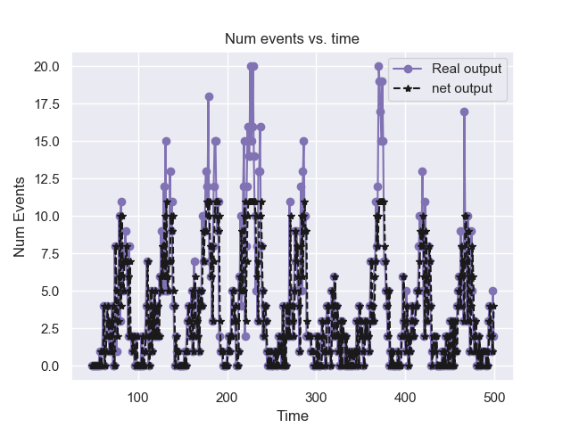
Network was evaluated on two types of data: raw, smooth
Input to network : k previous timesteps (k is a limited hyperparameter)
Step 2 : Probability Function, Machine Learning
Network results compared to raw data on busy location
Notes:
השוואה לפתרון השני

Slide 19
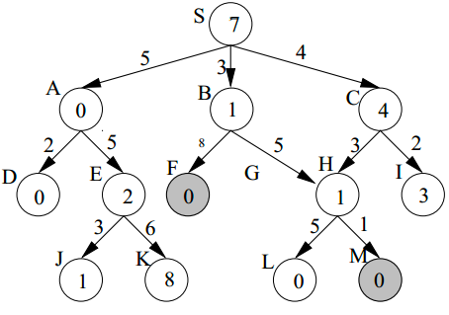
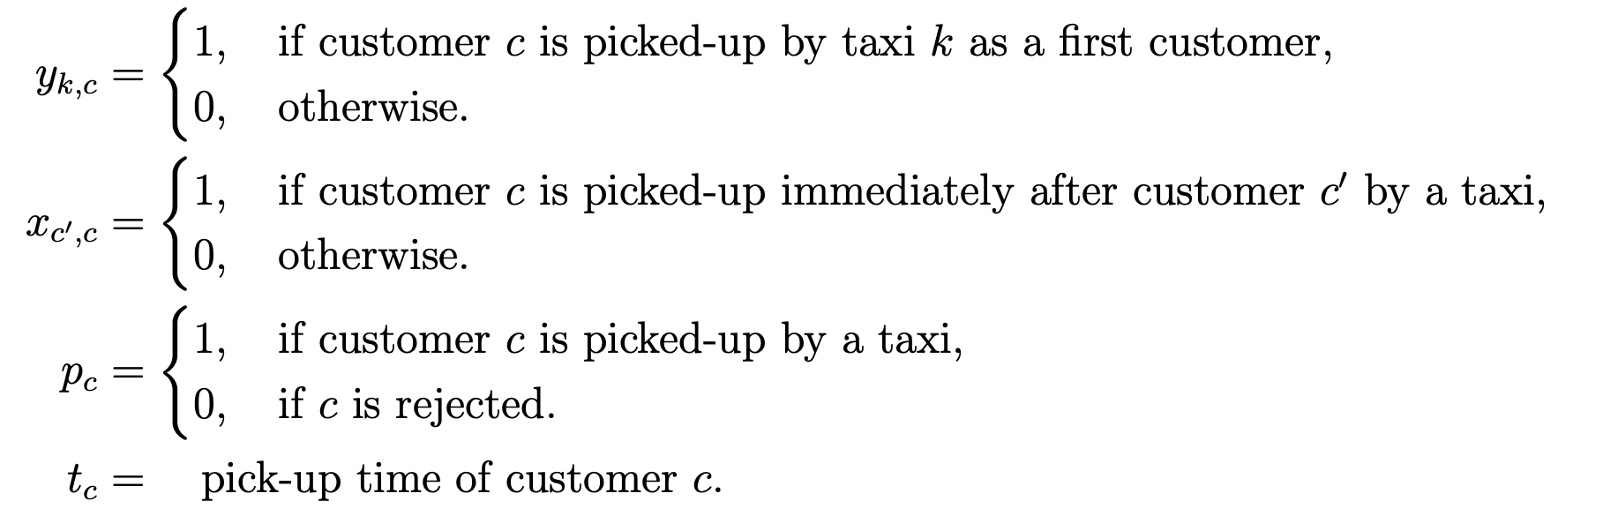
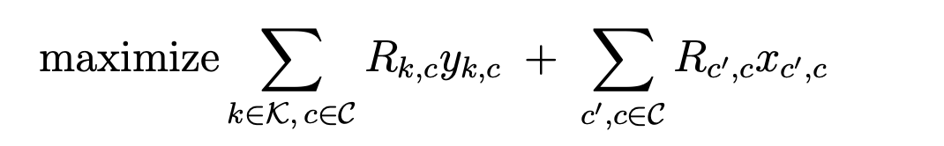
A* :
Find shortest path assuming the actual cost of each edge and the approximate future cost. Method uses BFS algorithm
MIP :
Find solution to optimization problem where the edges of the graphs are the unknown variables of optimization problem
Step 3 : Deterministic solver
In the process …
Reinforcement learning :
Learn the combined optimal policy for all cars using reinforcement learning methods

Slide 20
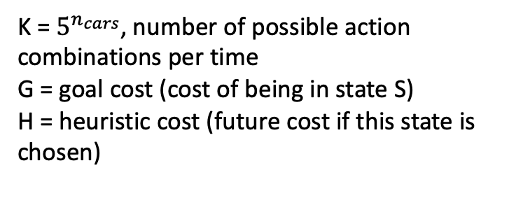
State:
Request information -
Location
Time until opened
Time until closed
Status (closed/opened)
Reward for reaching request
Penalty for canceling request
Car information –
Current location
List of requests reached
Step 3 :
A* explained
S1
$$s_{1,1}$$
𝑠_1,1
$$s_{1,3}$$
𝑠_1,3
$$S_{1,k}$$
𝑆_(1,𝑘)
$$s_{1,2}$$
𝑠_1,2
$$s_{1,1,1}$$
𝑠_1,1,1
$$s_{1,1,2}$$
𝑠_1,1,2
$$s_{1,1,k}$$
𝑠_(1,1,𝑘)
$$s_{1,2,1}$$
𝑠_1,2,1
$$s_{1,2,2}$$
𝑠_1,2,2
$$s_{1,2,k}$$
𝑠_(1,2,𝑘)
$$s_{1,3,1}$$
𝑠_1,3,1
$$s_{1,3,2}$$
𝑠_1,3,2
$$s_{1,3,k}$$
𝑠_(1,3,𝑘)
$$s_{1,k,1}$$
𝑠_(1,𝑘,1)
$$s_{1,k,2}$$
𝑠_(1,𝑘,2)
$$s_{1,k,k}$$
𝑠_(1,𝑘,𝑘)
…
K = $5^{n_{cars}}$, number of possible action combinations per time
G = goal cost (cost of being in state S)
H = heuristic cost (future cost if this state is chosen)
…
…
…
…
Notes:
Backup slide – heuristics

Slide 21
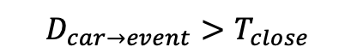

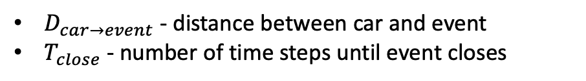
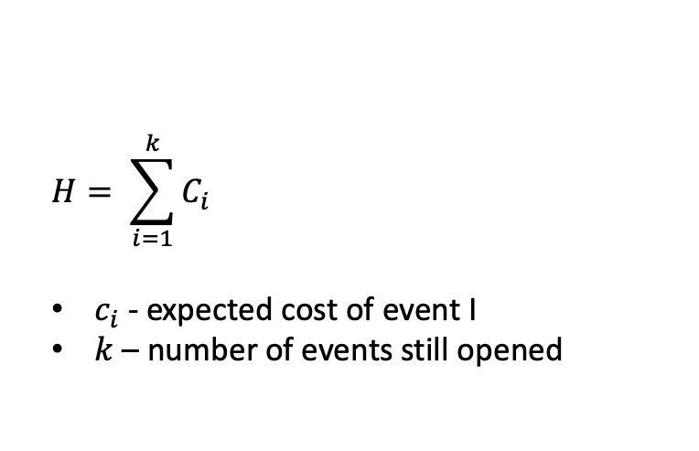
$$H= \sum_{i=1}^{k}{C_{i}}$$
$c_{i}$ - expected cost of event I
$k$ – number of events still opened
For each future/open event:
Step 3 :
A* heuristic
Find nearest car to event
$$D_{car→event}>T_{close}$$
$$D_{car→event}<T_{close}$$
Add cost of event being canceled
Add cost of driving to event + cost of event waiting + reward for closing event
$D_{car→event}$ - distance between car and event
$T_{close}$ - number of time steps until event closes

Slide 22
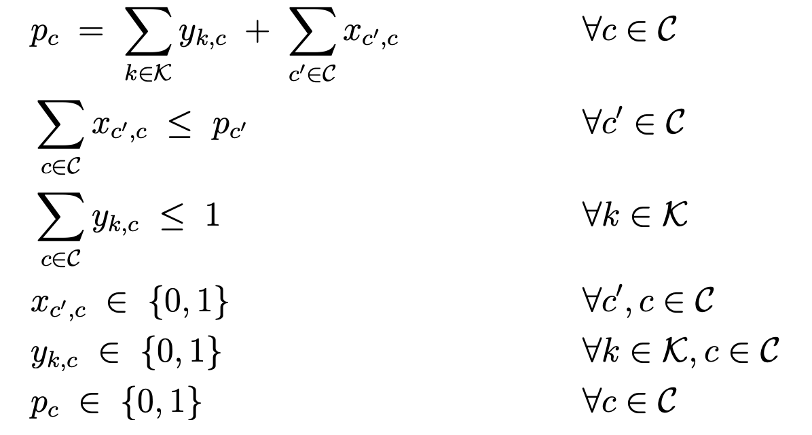
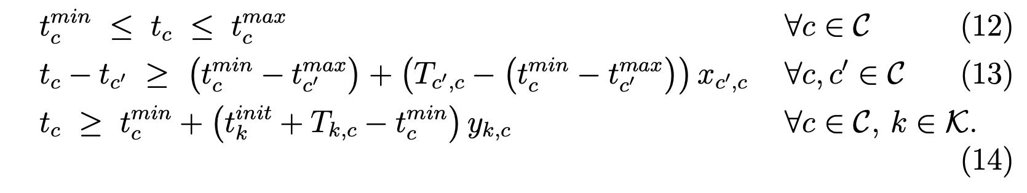
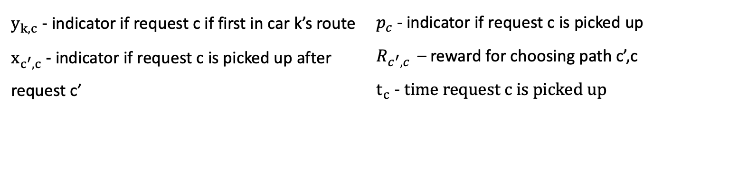
Variables
$y_{k,c}$ - indicator if request c if first in car k’s route
$x_{c^{′},c}$ - indicator if request c is picked up after request c’
$p_{c}$ - indicator if request c is picked up
$R_{c^{′},c }$ – reward for choosing path c’,c
$t_{c}$ - time request c is picked up
Step 3 :
MIP
explained
Constraints
Online Vehicle Routing: The Edge of Optimization in Large-Scale Applications. Operations Research 67(1): 143-162 (2019) Dimitris Bertsimas, Patrick Jaillet, S´ebastien Martin

Slide 23
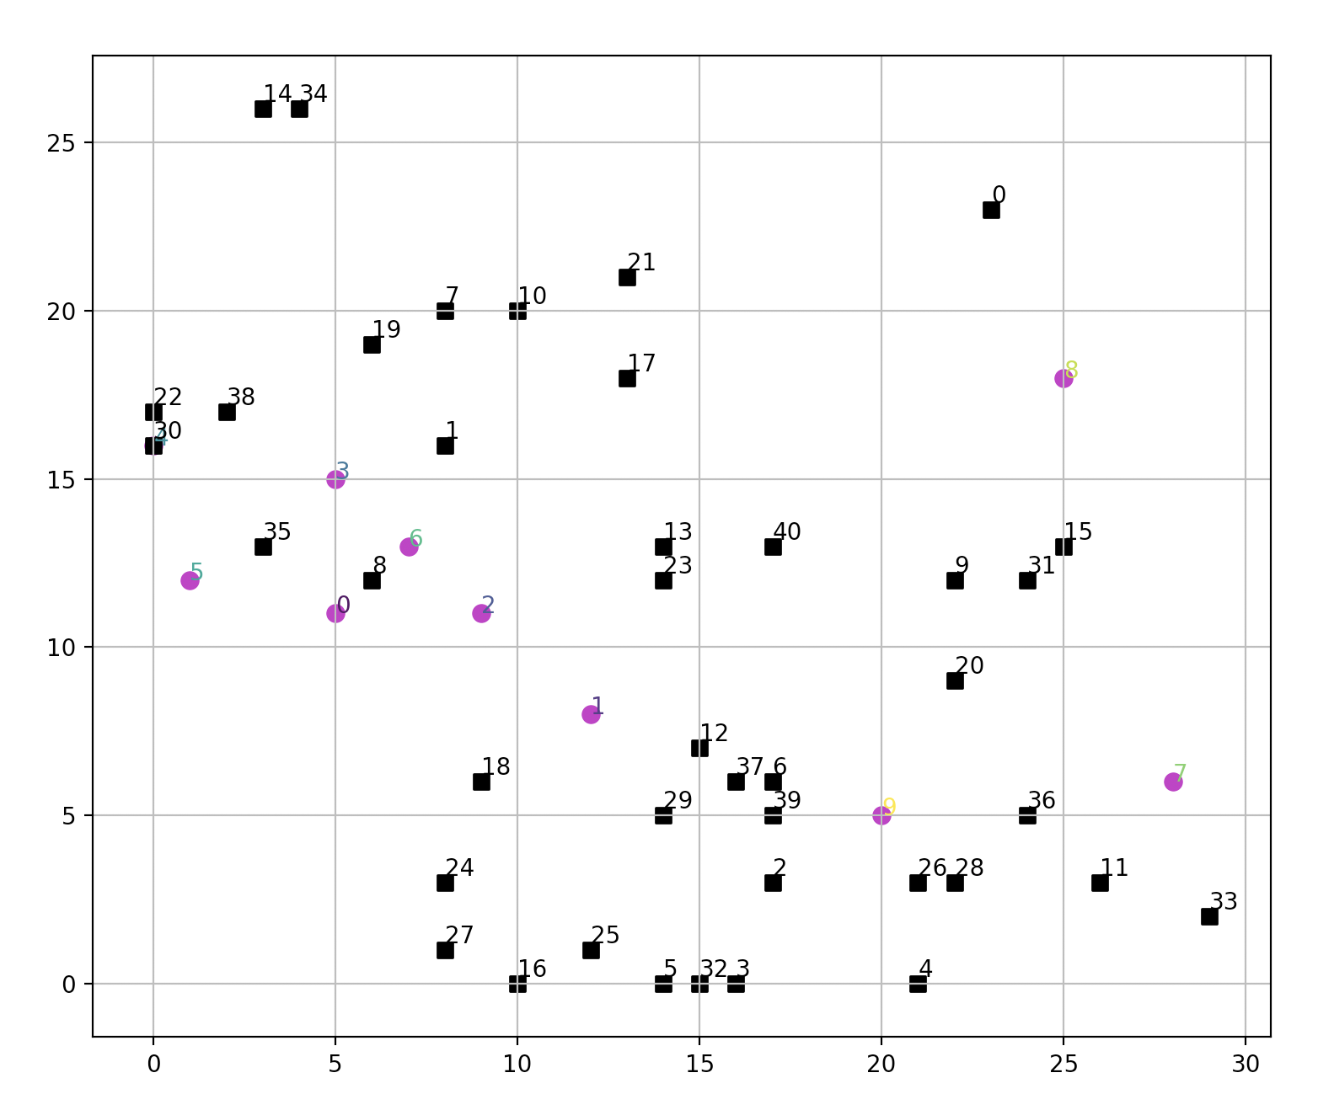
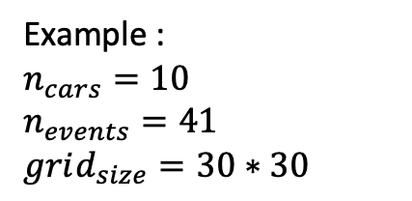
Example :
$$n_{cars}=10$$
$$n_{events}=41$$
$$grid_{size}=30∗30$$
Problem layout
Step 3 :
MIP
explained
requests
cars
Online Vehicle Routing: The Edge of Optimization in Large-Scale Applications. Operations Research 67(1): 143-162 (2019) Dimitris Bertsimas, Patrick Jaillet, S´ebastien Martin

Slide 24
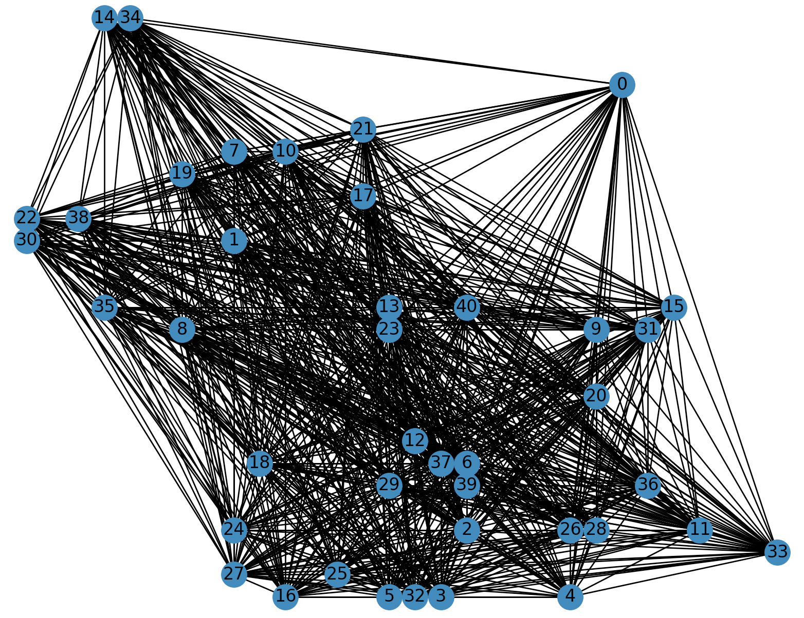


Fully connected graph, since each request can be potentially picked up after every other request
Full action space
Sim runtime - 0.55 s
Real car paths
Step 3 :
MIP
explained
Optimal solution
Only edges from optimal solution are left. Each weakly connected component in the dag is a different car’s path. (single nodes are requests that are not picked up due to cancelation)
Actual route that each car preforms (assuming Euclidian space)
Online Vehicle Routing: The Edge of Optimization in Large-Scale Applications. Operations Research 67(1): 143-162 (2019) Dimitris Bertsimas, Patrick Jaillet, S´ebastien Martin

Slide 25


For t from 1 to T:
Add new requests to S
For $i$ from 1 to N:
$f_{i} ←draw_{future}\left(G,H\right)$
For each action $a$ possible in W:
$s^{′}← <a\left(w\right), g>$
For $i$ from 1 to N:
$m_{i}←solve\left(s^{′},f_{i}\right)$
$m=\frac{1}{N}∙\sum_{i=1}^{N}{m_{i}}$
$Q\left(s,a\right)←C\left(s,a\right)+m$
Return $\underset{a}{argmin}{Q(s,a)}$
Move each car by action chosen and calculate cost and close requests reached by cars
N – number of stochastic runs (for estimating expected value of future requests)
$draw_{future}\left(G,H\right)$- assuming H future time steps, draw future requests from distribution function
Possible actions in W – all possible combinations for car movements ($5^{k}$ options per time step)
$solve\left(s^{′},f_{i}\right)$ - deterministic solver
m – expected value of future requests
Step 4 :
Anticipatory Algorithm

Slide 26


Comparing different prediction algorithms -
Step 4 :
Anticipatory Algorithm
$N_{cars}$ : 3
Grid size: 10*15
$N_{stochastic}$: 10
H: 7
Results with simple prediction function are as good as results with Neural network
Notes:
/Users/chanaross/dev/Thesis/Simulation/Anticipitory/with_machine_learning/NumCars/Results/SimAnticipatoryMio_RandomChoice_7lpred_1000startTime_10gridX_15gridY_55numEvents_10nStochastic_3numCars_Bm_easy_MaxFlow

Slide 27


For t from 1 to T:
Add new requests to S
For $i$ from 1 to N:
$f_{i} ←draw_{future}\left(G,H\right)$
For each action $a$ possible in W:
$s^{′}← <a\left(w\right), g>$
For $i$ from 1 to N:
$m_{i}←solve\left(s^{′},f_{i}\right)$
$m=\frac{1}{N}∙\sum_{i=1}^{N}{m_{i}}$
$Q\left(s,a\right)←C\left(s,a\right)+m$
Return $\underset{a}{argmin}{Q(s,a)}$
Move each car by action chosen and calculate cost and close requests reached by cars
Run only a subset of possible actions:
Randomize order of cars and run optimization for each car movement separately ($5∙k$ steps instead of $5^{k}$)
Calculate cost of dual movements (each time 2 cars move in all 5 options) and then run mini optimization to find optimal result
Step 5 :
Optimize Run-Time
Reduce deterministic run time:
Run Max flow problem instead of time window (shortens run time gradually since can be run without integer constraints)
Run reinforcement learning on deterministic problem. (shortens run time since now can run all action combinations as batch)

Slide 28


Step 5 :
Optimize Run-Time
$N_{cars}$ : 10
Grid size: 10*25
$N_{stochastic}$: 20
H: 5
Greedy anticipatory solution preforms very well, better than deterministic without time window and solution is not far from optimal solution
Notes:
/Users/chanaross/dev/Thesis/Simulation/Anticipitory/with_machine_learning/Results_presentation/SimAnticipatoryMio_RandomChoice_5lpred_4delOpen_48startTime_10gridX_25gridY_84numEvents_20nStochastic_10numCars_Bm_MaxFlow

Slide 29
Anticipatory algorithm result:
Greedy algorithm result:
Step 5 :
Optimize Run-Time
$N_{cars}$ : 10
Grid size: 10*25
$N_{stochastic}$: 20
H: 5

Slide 30
use reinforcement learning methods on the deterministic problem and run anticipatory algorithm in real time on larger problem
Calculate the stochastic problem using reinforcement learning and anticipatory as the Cost of algorithm
Future work

Slide 31
Input: nodes of graph
Problem is represented as graph
Nodes : locations of all requests
Edges : routes between requests
Encoder –
Multi head attention
Reinforcement learning
mTSP
Input to decoder : available nodes + graph embedding
Decoder car 1 –
Multi head attention
Decoder car 2 –
Multi head attention
Decoder car k –
Multi head attention
…
Fully connected layer
Attention, Learn to Solve Routing Problems!, International Conference on Learning Representations
Wouter Kool and Herke van Hoof and Max Welling
output: k probability functions, each one represents if car k will pick up nodes that are still available

Slide 32
Many problems today can be formalized as a number of agents and requests needed to be answered
We suggest an algorithm that uses historical data in order to plan better for the unknown future
Our solution is like the anticipatory online algorithm and adds the prediction learner
We show great results on a real-life problem : uber in Manhattan
We were able to optimize run-time using gurobi and defining the internal optimization problem as a MIP
The anticipatory algorithm shows similar results to the optimal deterministic solution
Summary

Slide 33

For t from 1 to T:
Add new requests to S
For each action $a$ possible in W:
$s^{′}← <a\left(w\right), g>$
For $i$ from 1 to N:
$f_{i} ←draw_{future}\left(G,H\right)$
$m_{i}←solve\left(s^{′},f_{i}\right)$
$m=\frac{1}{N}∙\sum_{i=1}^{N}{m_{i}}$
$Q\left(s,a\right)←C\left(s,a\right)+m$
Return $\underset{a}{argmin}{Q(s,a)}$
Move each car by action chosen and calculate cost and close requests reached by cars

Slide 34


Results , MIP, Max Flow solution -
Step 4 :
Anticipatory Algorithm
$N_{cars}$ : 4
Grid size: 10*15
$N_{stochastic}$: 20
H: 5
Anticipatory algorithm shows great improvement compared to greedy algorithm
Anticipatory is using max flow as deterministic algorithm and shows similar results to deterministic solution
Notes:
/Users/chanaross/dev/Thesis/Simulation/Anticipitory/with_machine_learning/Results_presentation/SimAnticipatoryMio_BruteForce_5lpred_4delOpen_1000startTime_10gridX_15gridY_20numEvents_20nStochastic_4numCars_Bm_MaxFlow.p

Slide 35


W – world
G – known goals
A – available actions
S –$<W,G>$
T - transition function probability from S’ to S
$C_{H}\left(s,a\right)$ – cost of preforming action A given state S
H – number of look ahead steps
P – distribution of future goals
Important: since the problem has stochastic goals, the plan is updated and therefore a full plan is irrelevant, and we optimize only H steps forward
OCPP - Problem Definition
Anticipatory on-line planning, ICAPS’12
Ethan Burns, J. Benton, Wheeler Ruml, Sungwook Yoon, and Minh B. Do.
Total cost $→C_{H}\left(s,a\right)=\sum_{i=1}^{H}{C\left(s_{i},a_{i}\right)}$
Notes:
להפוך אולי לגרפי

Slide 36

Problem formulation
$N_{k}$ - number of cars
$N$ – total number of costumers in simulation (stochastically created throughout the simulation)
T – simulation length
$t_{0}$ - simulation start time, $t_{i}$ – time step during simulation
$\left(t_{min}^{c},t_{max}^{c}\right)$ - time window to pick up costumer c
$t_{c}$ - pickup time of costumer c
$\{\left(0,1\right),\left(1,0\right),\left(0,0\right),\left(−1,0\right),(0,−1)\}$ – set of possible actions each car can preform
$\vec{a_{t}}∈{\left\{\left(0,1\right),\left(1,0\right),\left(0,0\right),\left(−1,0\right),\left(0,−1\right)\right\}}^{N_{k}}$ - action chosen for each car at time t
$A_{T}=\{\vec{a_{1}},\vec{a_{2}},…,\vec{a_{T}}\}$ – final set of actions for given simulation from time 0 to time T
$S_{t}$ - state of world at time t, (car locations, opened requests)

Slide 37

Deterministic problem – Mathematical Definition
K - set of drivers
n – nodes in graph representing Manhattan
C - set of costumers throughout the day
$t_{0}$ - simulation start time
$\left(t_{min}^{c},t_{max}^{c}\right)$ - time window to pick up costumer c
$T_{c′,c}$- time to travel between costumer c’ to costumer c
$t_{c}$ - pickup time of costumer c
$R_{c^{′},c}$ - reward of driving from costumer c’ to costumer c
Notes:
יש ניסוח של הבעיה בתור M|IP שמגיעה מתוך MIT ועם עושים רילסקציה של הזמן עדיין מגיעים לפתרון אופטימאלי

